Slide 1
Review: String, formulas, Math, Scanner & data structures
Dr. Jeff Hill

Slide 2
Expressions
Expressions, algorithms, formulas, etc.
All words for the same general concept
Mixing numbers, variables, and mathematical operations to get desired results
Java follows traditional order of operations (PEMDAS)
Java provides basic mathematical operators (+, -, *, /)
Division is twofold
Integer division → 18 / 7 = 2
Has a modulus operator to get the remainder → 18 % 7 = 4
Floating point → 18.0 / 7.0 = 2.5714285714285716

Slide 3
Expressions with string concatenation
String concatenation can make output not what we expect
This output is incorrect!
System.out.println("18 + 7 = " + 18 + 7); ← 18 + 7 = 187
This output is correct!
System.out.println("18 + 7 = " + (18 + 7)); ← 18 + 7 = 25

Slide 4
Counting
Using variables to count is a very frequent programming operation
Starting with this:
int counter = 0;
4 ways to increment
counter = counter + 1;
counter += 1;
counter++;
++counter;
What is the difference between ++counter and counter++?

Slide 5
Data conversion
Java is a strongly typed language
Java provides many conversion mechanisms
Some automatic
Some simple to use
Some difficult to use

Slide 6
Data conversion
Widening conversion
Automatic, used when no information would be lost
16 + 8 = 24.0 ← “up-converting” from integers to a double
Narrowing conversion
Must be explicitly performed, used when information would be lost
16.2 + 8.4 = 24 ← “down-converting” from doubles to an integer
AKA explicit type casting, this truncates decimal values!
Parsing
Must be explicitly performed, used when converting very different data types
“16” + “8” = 24 ← parsing the string literals into numeric literals to an integer

Slide 7
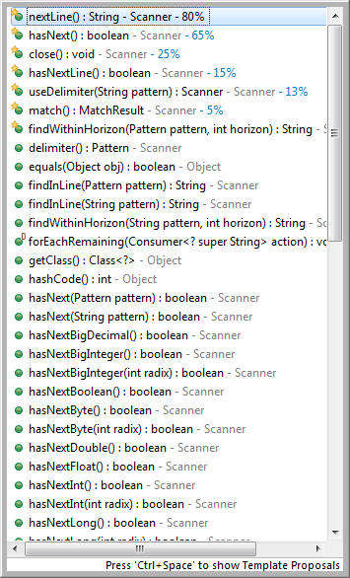
Interactivity
Python uses the input() function to allow us to get user’s data
Java isn’t nearly so simple…
Uses the Scanner class
This is a reference data type (notice the capital letter)
Contrast with primitive data types: int, double, etc.
Reference types provide a library of functions specific to each type
More powerful than simple Python mechanism, but more complex to use
Must import the Scanner class into our class’ code
import java.util.Scanner; ← goes after package statement, before class statement
Must instantiate a variable of the Scanner type
Scanner userInput = new Scanner(System.in);

Slide 8
Interactivity
Eclipse will warn about a “resource leak” for not closing the Scanner object
Don’t worry about this!
And don’t close the object as it will permanently close the System.in as well!
Now we can collect as many data points as we need
Must provide the user a prompt of what they should enter
Otherwise it just sits there with a blinking cursor…
System.out.println("Please enter your first name: ");
Capture the value the user enters into a variable
Rule of thumb: capture everything as a string literal, then convert as needed…
String fName = userInput.nextLine();
Use this String variable any way you wish…
System.out.println("Hello " + fName + ", nice to meet you.");

Slide 9
Interactivity with data conversion
Text shows reading in directly as integers, doubles, etc.
Avoid doing this!
This technique will lead to issues with extra or missing CR/LF!
Read as String types
System.out.println("Please enter your age in years: ");
String age = userInput.nextLine();
Convert to appropriate numeric type as needed
Integer.valueOf() & Double.valueOf() are the two commonly used methods
System.out.println("In 10 years you will be " + (Integer.valueOf(age) + 10) + " years old.");

Slide 10
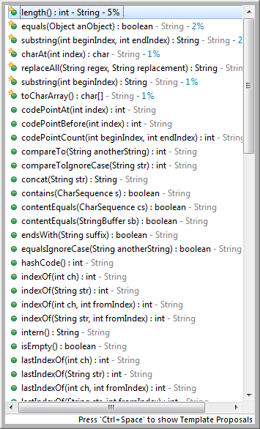
String manipulations
The String data type is also a reference type
It has its own library of functions
.toUpperCase()
.toLowerCase()
.substring(x)
.charAt(x)

Slide 11
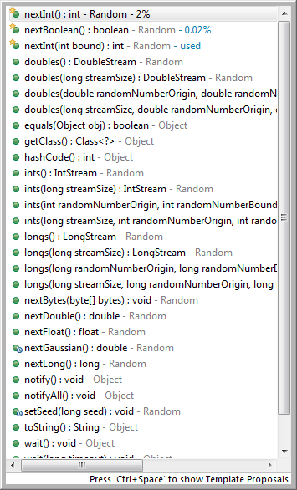
Randomization
Java includes the Random class to provide basic randomization needs
Also has a required import statement
import java.util.Random;
Must instantiate a variable of the Random type, just like Scanner
Random rng = new Random();
Java’s generator follows the uniform distribution
Java’s generator creates pseudo-random numbers

Slide 12
Randomization
2 general use cases (there are others)
Random integers
rng.nextInt(maxValue);
Generates a random number between 0 (inclusive) and maxValue (exclusive)
Random decimal value
rng.nextDouble();
Only generates a random number between 0 (inclusive) and 1 (exclusive)
Multiply the result if you need larger values
double randomDecimal = rng.nextDouble() * 10;

Slide 13
Randomization offsets (integers)
We don’t always want to start at 0
Use a process called offsetting
Get your minimum value
int minimum = Integer.valueOf(userInput.next());
Get your maximum value
int maximum = Integer.valueOf(userInput.next());
Determine the window size between minimum and maximum
int window = maximum - minimum;
Generate a random number based on the window, then offset by the minimum
int example = rng.nextInt(window) + minimum;

Slide 14
Randomization offsets (doubles)
Similar process for double values
Get your minimum value
double minimum2 = Double.valueOf(userInput.nextLine());
Get your maximum value
double maximum2 = Double.valueOf(userInput.nextLine());
Determine the window size between minimum and maximum
double window2 = maximum2 – minimum2;
Generate a random decimal multiply by the window, then offset by the minimum
double example2 = rng.nextDouble() * window2 + minimum2;

Slide 15
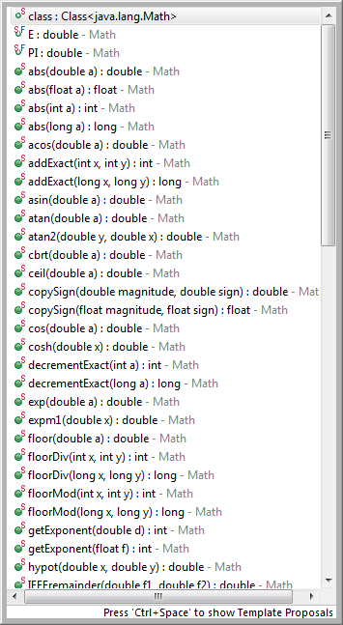
Enhanced math functions
Other math functions are provided in Java’s Math class
These are static class functions, makes it easier to use, no instantiations
Math.sqrt(x);
Math.abs(x);
Math.pow(base, exponent);

Slide 16
1D data structures
Java provides many different data structures
This is equivalent to Python’s lists
Multiple values under a single variable reference name
Most basic type:
Array
Easy to use, but one big limitation
Can’t be resized (bigger or smaller)
Usage same for every data type
Uses brackets [ ] and index values

Slide 17
Array
int[] lotsOfNumbers = new int[5];
lotsOfNumbers[0] = 5;
lotsOfNumbers[1] = 10;
lotsOfNumbers[2] = 15;
lotsOfNumbers[3] = 20;
lotsOfNumbers[4] = 25;
System.out.println(lotsOfNumbers[0] + ", " + lotsOfNumbers[1] + ", " + lotsOfNumbers[2] + ", " + lotsOfNumbers[3] + ", " + lotsOfNumbers[4]);

Slide 18
Array initializer list
This can be significantly simplified if you know all values ahead of time
int[] lotsOfNumbers2 = {10, 20, 30, 40, 50};
System.out.println(lotsOfNumbers2[0] + ", " + lotsOfNumbers2[1] + ", " + lotsOfNumbers2[2] + ", " + lotsOfNumbers2[3] + ", " + lotsOfNumbers2[4]);

Slide 19
ArrayList
Arrays all suffer from same problem, can’t change size
We frequently don’t know how many values we will need
We just need to store until there are no more values to enter
How can we define a fixed size data structure if we don’t know the fixed size!?
ArrayList was created for just this problem
Dynamically resizable, Java handles resizing in the background
Similar usage to an array, but some differences
Uses .add() and .get() methods along with index values
Required: import java.util.ArrayList;
Uses <reference types only> to indicate the underlying data type
Must instantiate a variable that will refer to the ArrayList
ArrayList<Integer> allNumbers = new ArrayList<Integer>();

Slide 20
ArrayList
ArrayList<Integer> allNumbers = new ArrayList<Integer>();
allNumbers.add(100);
allNumbers.add(200);
allNumbers.add(300);
allNumbers.add(400);
allNumbers.add(500);
System.out.println(allNumbers.get(0) + ", " + allNumbers.get(1) + ", " + allNumbers.get(2) + ", " + allNumbers.get(3) + ", " + allNumbers.get(4));
ArrayLists can’t be declared for any primitive data types!

Slide 21
Questions?

